Slide 1
MGMT 6055 Project Scope & requirements
LAWRENCE KINLIN SCHOOL OF BUSINESS
MODULE 11
Notes:
Used when no picture is available.

Slide 2

Learning Objectives
Review Six Sigma methodology
Detailed process maps with swim lanes

Slide 3
Recall: SIX SIGMA
From last module
A management philosophy
Features themes, techniques and tools for process improvement
Involves setting high objectives, collecting data, analyzing results for the purpose of reducing defects/inefficiencies in products/services

Slide 4
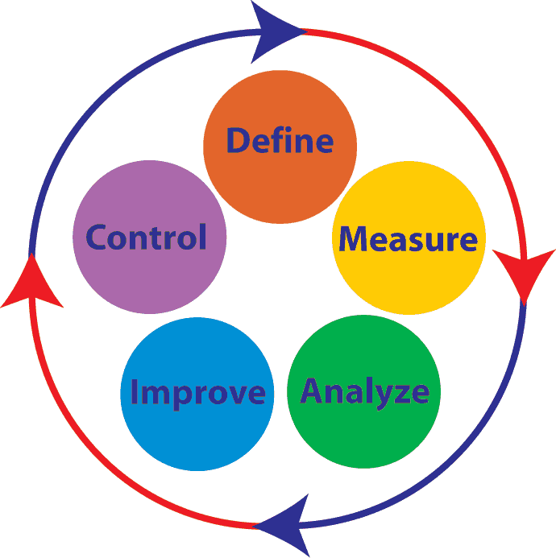
RECALL: DMAIC METHODOLOGY
This is the principle methodology used in Six Sigma
Pronounced “duh – MAY – ick”
It is a cyclical methodology, representing continual improvement
Elements:
Define
Measure
Analyze
Improve
Control
From last module

Slide 5
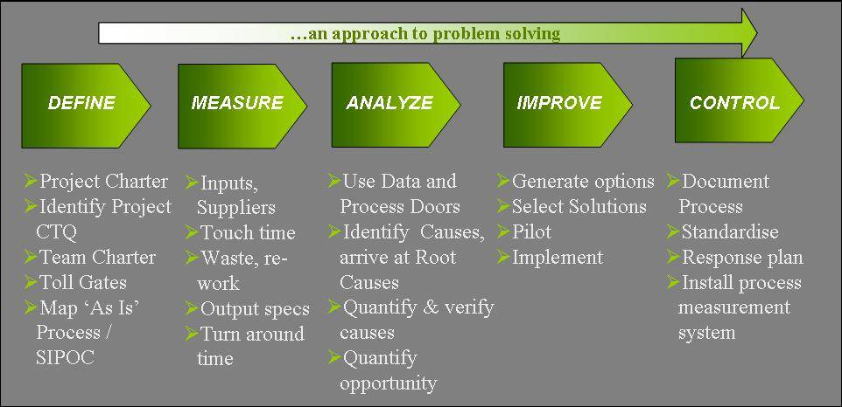
RECALL: DMAIC METHODOLOGY
From last module
See “Notes” for this slide for explanations (Notes View in PPT, which shows comments/notes below the PPT slide on your screen)
Notes:
CTQ = Critical to quality = similar to acceptance criteria (what are the success criteria for this improvement project – eg performance requirements, specification limits)
Toll Gates = A SIPOC diagram is a tool used by a team to identify all relevant elements of a process improvement project before work begins.
Toll Gates = Are there any “go/no-go” decision-stages in the project?
SIPOC = Suppliers, Inputs, Process, outputs, Customers Rqmt’s (see following slides)
Touch time = Are there any parts of the process where there is idle time? We want to understand how much time in a process is spent where the product is being manipulated/created versus slack time. Too much slack time might imply process inefficiencies.
Turn around time = The entire cycle time for the process, from start to finish
Pilot = Rolling out implementation for a limited period of time, or to limited locations, to test the implementation of the solution (to make sure the solution is working).

Slide 6
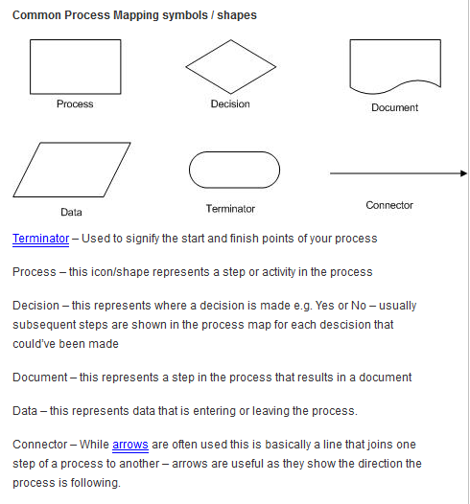
Define: Process Maps
Process maps show the sequence/ arrangement of tasks in a process or system
They work best for linear, sequential processes
They often incorporate standard flowchart symbols
For the final assignment, your process map should be formatted properly using these symbols!
Notes:
Source: http://www.valuestreamguru.com/?p=116

Slide 7
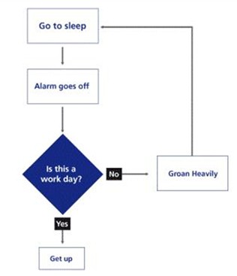
Example of a Simple Process Map
Can you identify the errors in the symbols in this process map?
Notes:
Source: http://www.qihub.scot.nhs.uk/knowledge-centre/quality-improvement-tools/process-mapping.aspx

Slide 8
PROCESS MAPS … WITH SWIM LANES
Swim lanes are columns or rows that are overlaid on process maps
Each swim lane represents a different actor (person/ department/ function/ entity) that is involved in the process being mapped
All tasks within each swim lane are completed by the same person/ department/ function/ entity
Tasks may overlap (stretch across) multiple swim lanes if more than one entity is involved in the completion of the task…
Swim lanes make it easier to determine where to measure process activities and implement solutions
To understand swimlanes better, click on this Youtube video.

Slide 9
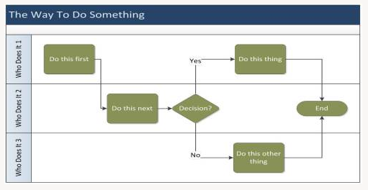
Process Map… with Swim Lanes
Title of Process
Person/ Role/ Entity
Notes:
Source: http://nancyschultzconsulting.wordpress.com/2012/10/15/part-3-process-redesign-techniques-for-organizational-restructuring/

Slide 10
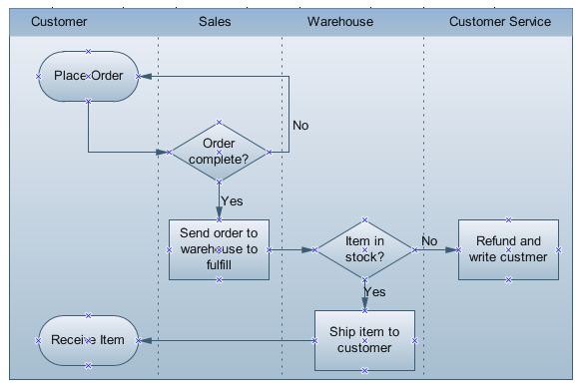
Example: Process Map…with Swim Lanes
Notes:
Source: http://www.edrawsoft.com/Cross-Functional-Flowcharts.php

Slide 11
Readings/Videos*
The Youtube video from Slide 8: https://www.youtube.com/watch?v=lC9gqw2_HTk
Video (view from start to 5:00) – “Swimlane Diagram Tutorial”: https://www.youtube.com/watch?v=Cm1n30o9jjM
Web article “Swim Lane Diagrams – Mapping and Improving the Processes in Your Organization”:
*You may be tested on this material for the final exam!
To view the embedded article, view the slide in Slide Editor mode (not Presentation mode) and double-click to open.
Notes:
Group project
11

Slide 12
Practice Activity
Remember the McDonalds process improvement videos from last module? Let’s practice drawing a process map for McDonalds.
Working on your own or in small groups, sketch a process map with swimlanes on a piece of blank paper.
Notes:
Don’t include the process for drive-through customers.
The process starts when a customer walks into the restaurant.
The process ends when a customer leaves the restaurant.
The customer may choose to eat in the restaurant OR take the food out in a bag.
Notes:
Group project
12

